Slide 1
Chapter 1 Computers and Digital Basics

Slide 2
Section A: All Things Digital
The Digital Revolution
Data Processing
Personal Computing
Network Computing
Cloud Computing
Digital Society

Slide 3
The Digital Revolution
The digital revolution is an ongoing process of social, political, and economic change brought about by digital technology, such as computers and the Internet
The technology driving the digital revolution is based on digital electronics and the idea that electrical signals can represent data, such as numbers, words, pictures, and music

Slide 4
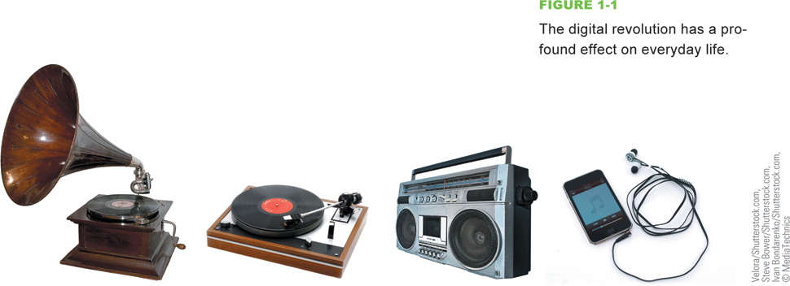
The Digital Revolution
Digitization is the process of converting text, numbers, sound, photos, and video into data that can be processed by digital devices
The digital revolution has evolved through four phases, beginning with big, expensive, standalone computers, and progressing to today’s digital world in which small, inexpensive digital devices are everywhere

Slide 5
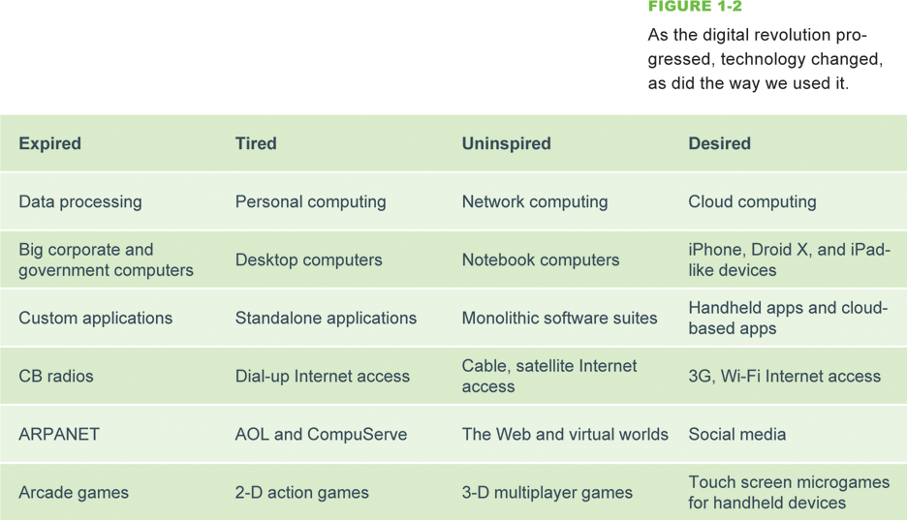
The Digital Revolution

Slide 6
Data Processing
Some historians mark the 1980s as the beginning of the digital revolution, but engineers built the first digital computers during World War II for breaking codes and calculating missile trajectories
Computers were operated by trained specialists
Back then, processing components for computers were housed in closet-sized cabinets that did not usually include a keyboard or display device

Slide 7
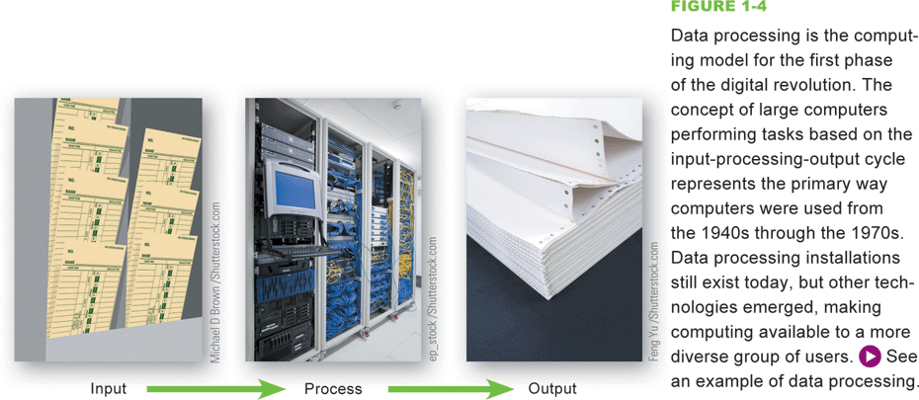
Data Processing
Data processing is based on an input-processing-output cycle
Data goes into a computer, it is processed, and then it is output

Slide 8
Personal Computing
The model for the second phase of the digital revolution, personal computing is characterized by small, standalone computers powered by local software
Local software refers to any software that is installed on a computer’s hard drive

Slide 9
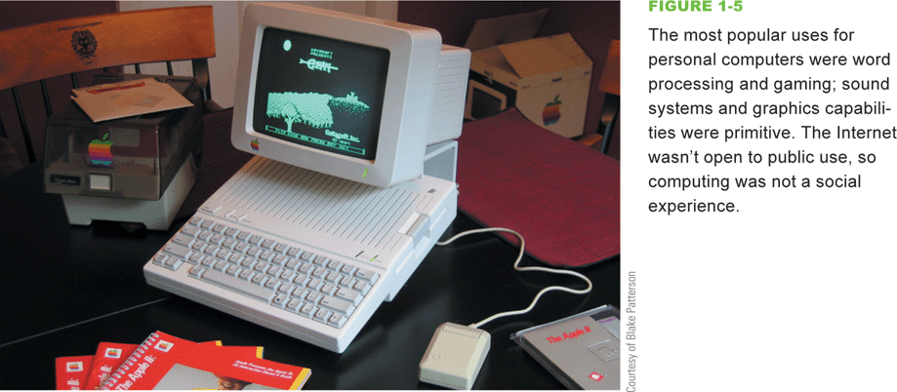
Personal Computing

Slide 10
Network Computing
The third phase of the digital revolution materialized as computers became networked and when the Internet was opened to public use
A computer network is a group of computers linked together to share data and resources
The Internet is a global computer network originally developed as a military project, and was then handed over to the National Science Foundation for research and academic use

Slide 11
Network Computing
The Web (short for World Wide Web) is a collection of linked documents, graphics, and sounds that can be accessed over the Internet
During the period from 1995–2010, computing was characterized by the Web, e-mail, multiplayer games, music downloads, and enormous software applications, such as Microsoft Office, Norton’s Internet Security Suite, and Corel Digital Studio

Slide 12
Cloud Computing
Local applications are being eclipsed by cloud computing, which characterizes the fourth phase of the digital revolution
Cloud computing provides access to information, applications, communications, and storage over the Internet
The expansion of cloud computing is due in part to convergence, a process by which several technologies with distinct functionalities evolve to form a single product

Slide 13
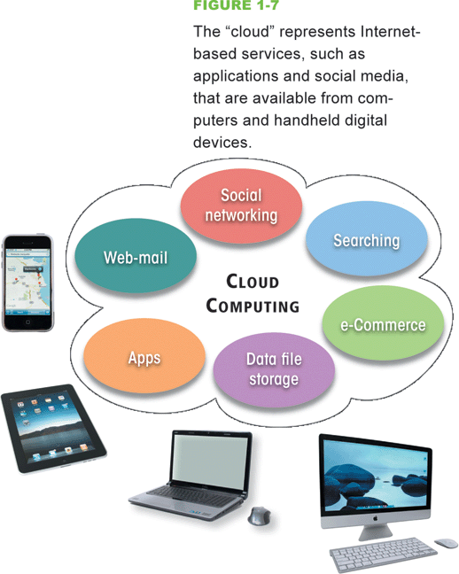
Cloud Computing

Slide 14
Cloud Computing
In 2010, the average consumer owned more than 24 digital devices
Convergence is important to the digital revolution because it created sophisticated mobile devices whose owners demand access to the same services available from full-size computers on their desks
Social media are cloud-based applications designed for social interaction and consumer-generated content

Slide 15
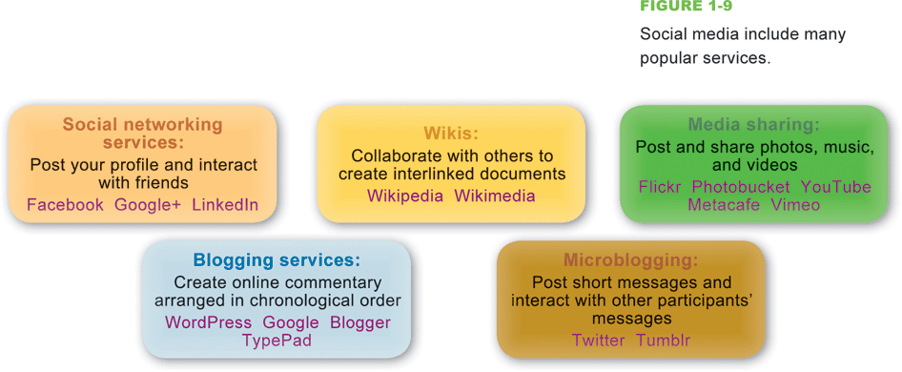
Cloud Computing

Slide 16
Digital Society
Digital technologies and communications networks make it easy to cross cultural and geographic boundaries
Anonymous Internet sites, such as Freenet, and anonymizer tools that cloak a person’s identity, even make it possible to exercise freedom of speech in situations where reprisals might repress it
Citizens of free societies have an expectation of privacy
Intellectual property refers to the ownership of certain types of information, ideas, or representations

Slide 17
Digital Society
Digital technology is an important factor in global and national economies, in addition to affecting the economic status of individuals
Globalization can be defined as the worldwide economic interdependence of countries that occurs as cross-border commerce increases and as money flows more freely among countries
Some individuals are affected by the digital divide, a term that refers to the gap between people who have access to technology and those who do not
Digital technology permeates the very core of modern life

Slide 18
Section B: Digital Devices
Computer Basics
Computer Types and Uses
Microcontrollers

Slide 19
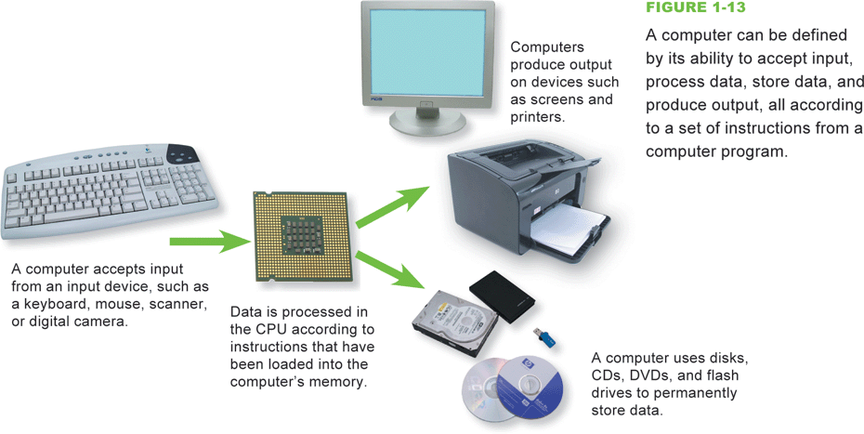
Computer Basics
A computer is a multipurpose device that accepts input, processes data, stores data, and produces output, all according to a series of stored instructions

Slide 20
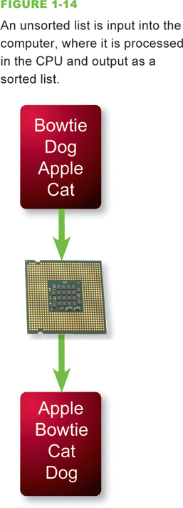
Computer Basics
Computer input is whatever is typed, submitted, or transmitted to a computer system
Output is the result produced by a computer
Data refers to the symbols that represent facts, objects, and ideas
Computers manipulate data in many ways, and this manipulation is called processing
Central Processing Unit (CPU)
Microprocessor

Slide 21
Computer Basics
Memory is an area of a computer that temporarily holds data waiting to be processed, stored, or output
Storage is the area where data can be left on a permanent basis when it is not immediately needed for processing
A file is a named collection of data that exists on a storage medium
The series of instructions that tells a computer how to carry out processing tasks is referred to as a computer program
Software

Slide 22
Computer Basics
A stored program means that a series of instructions for a computing task can be loaded into a computer’s memory
Allows you to switch programs
Distinguishes a computer from other simpler and less versatile digital devices

Slide 23
Computer Basics
Application software is a set of computer programs that helps a person carry out a task
Software applications are sometimes referred to as apps, especially in the context of handheld devices
The primary purpose of system software is to help the computer system monitor itself in order to function efficiently
Operating system (OS)

Slide 24
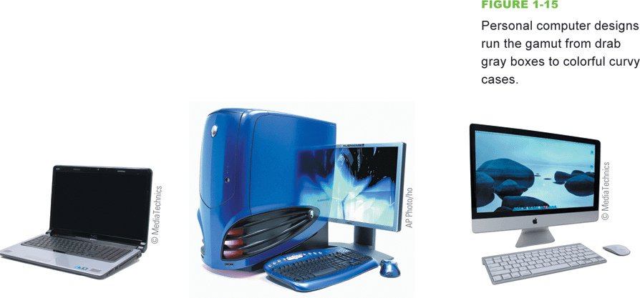
Computer Types and Uses
A personal computer is a microprocessor-based computing device designed to meet the computing needs of an individual

Slide 25
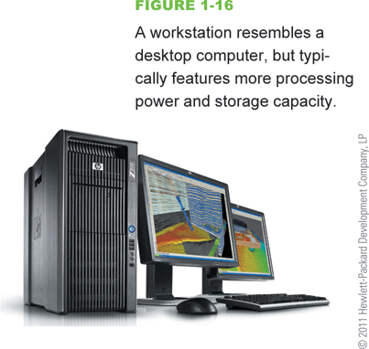
Computer Types and Uses
The term workstation has two meanings:
An ordinary personal computer that is connected to a network
A powerful desktop computer used for high-performance tasks

Slide 26
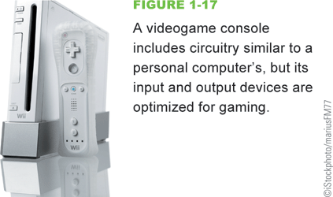
Computer Types and Uses
A videogame console, such as Nintendo’s Wii, Sony’s PlayStation, or Microsoft’s Xbox, is not generally referred to as personal computer because of their history as dedicated game devices

Slide 27
Computer Types and Uses
The purpose of a server is to serve computers on a network (such as the Internet or a home network) by supplying them with data
A mainframe computer (or simply a mainframe) is a large and expensive computer capable of simultaneously processing data for hundreds or thousands of users
A computer falls into the supercomputer category if it is, at the time of construction, one of the fastest computers in the world
A compute-intensive problem is one that requires massive amounts of data to be processed using complex mathematical calculations

Slide 28
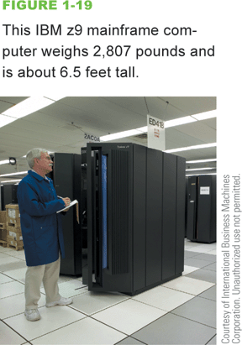
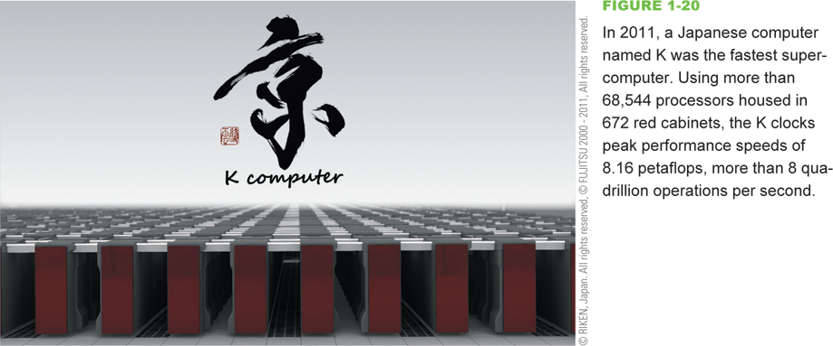
Computer Types and Uses

Slide 29
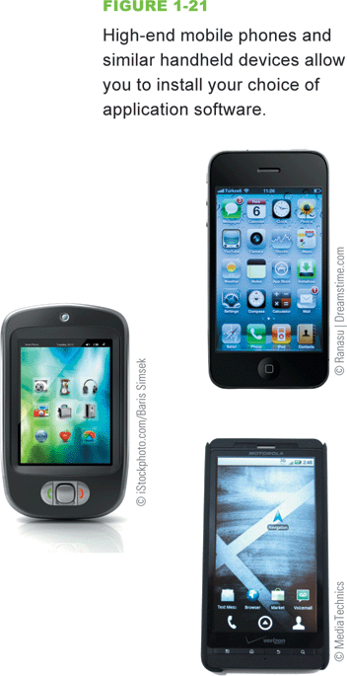
Computer Types and Uses
Handheld digital devices include familiar gadgets such as iPhones, iPads, iPods, Garmin GPSs, Droids, and Kindles
Handheld devices can be divided into two broad categories: those that allow users to install software applications (apps) and those that do not
Handheld computer

Slide 30
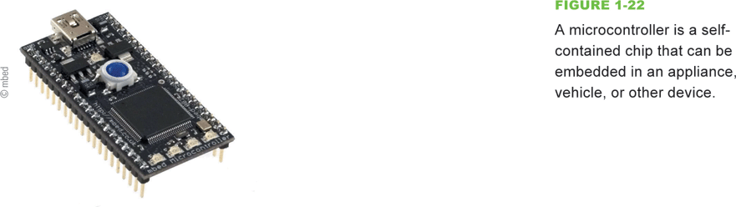
Microcontrollers
A microcontroller is a special-purpose microprocessor that is built into the machine it controls
Microcontrollers can be embedded in all sorts of everyday devices

Slide 31
Section C: Digital Data Representation
Data Representation Basics
Representing Numbers, Text, Images, and Sound
Quantifying Bits and Bytes
Circuits and Chips

Slide 32
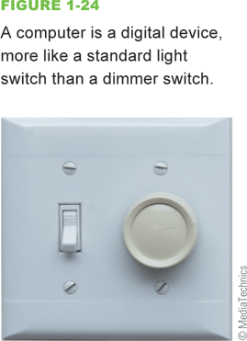
Data Representation Basics
Data representation refers to the form in which data is stored, processed, and transmitted
Digital data is text, numbers, graphics, sound, and video that has been converted into discrete digits such as 0s and 1s
Analog data is represented using an infinite scale of values

Slide 33
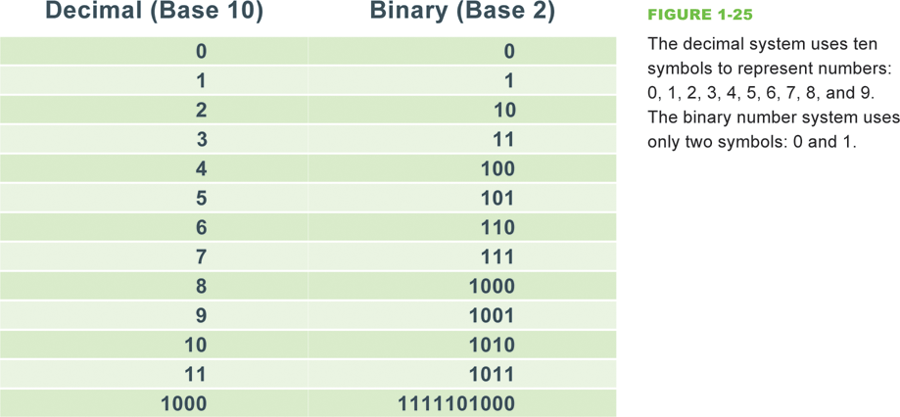
Representing Numbers, Text, Images, and Sound
Numeric data
Binary number system
Character data
ASCII, Extended ASCII, EBCDIC, and Unicode

Slide 34
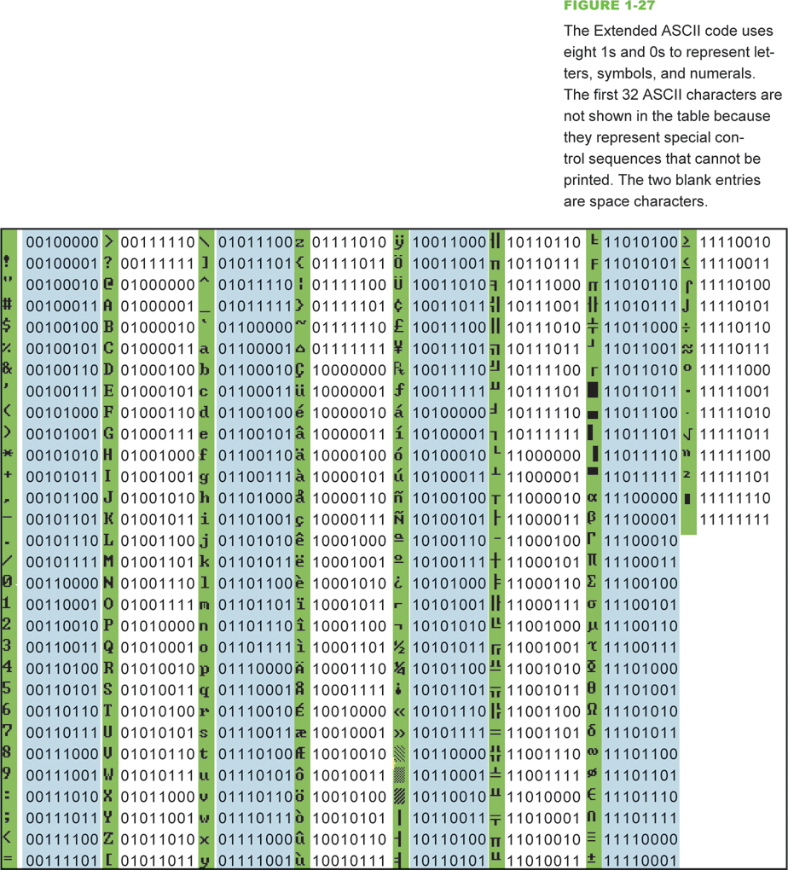
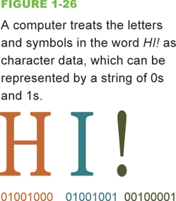
Data Representation

Slide 35
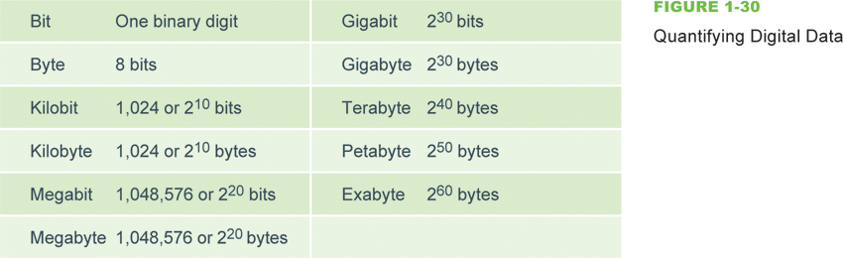
Quantifying Bits and Bytes

Slide 36
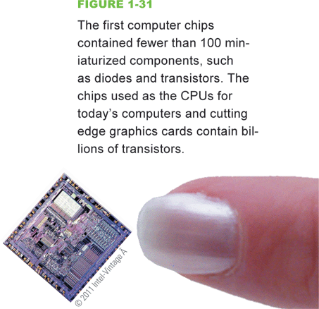
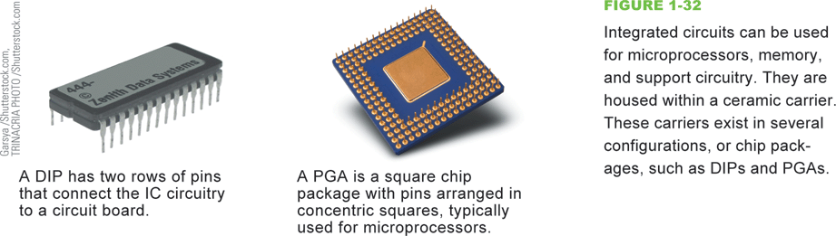
Circuits and Chips
An integrated circuit (IC) is a super-thin slice of semiconducting material packed with microscopic circuit elements

Slide 37
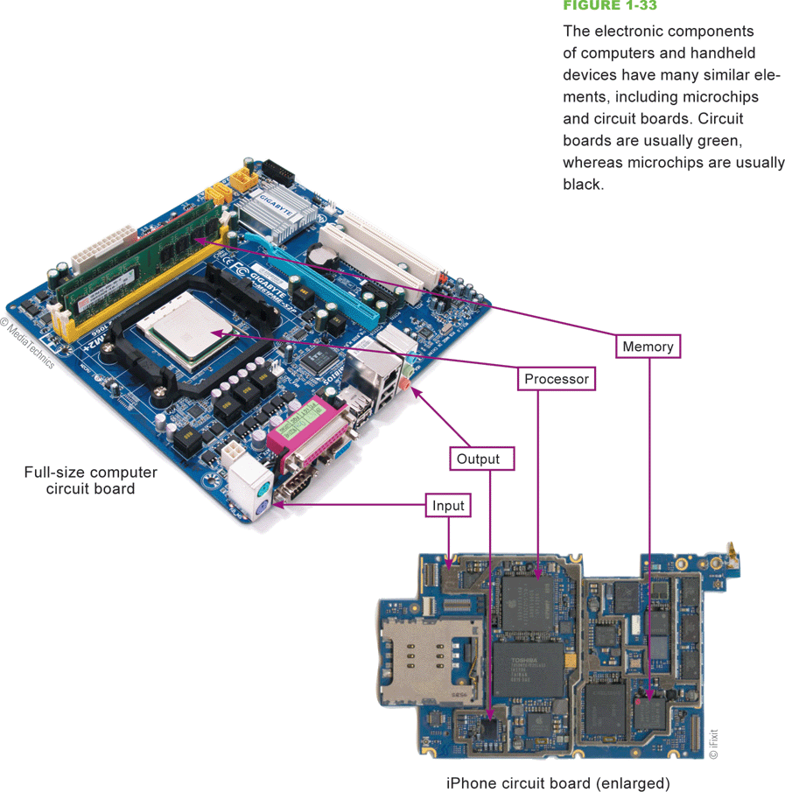
Circuits and Chips
The electronic components of most digital devices are mounted on a circuit board called a system board, motherboard, or main board

Slide 38
Section D: Digital Processing
Programs and Instruction Sets
Processor Logic

Slide 39
Programs and Instruction Sets
Computers and dedicated handheld devices all work with digital data under the control of a computer program
Computer programmers create programs that control digital devices; these programs are usually written in a high-level programming language
The human-readable version of a program created in a high-level language by a programmer is called source code

Slide 40
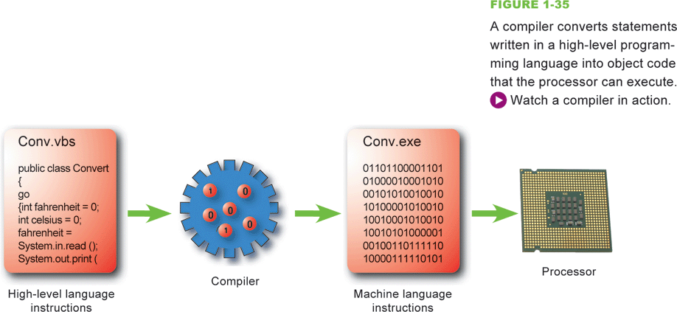
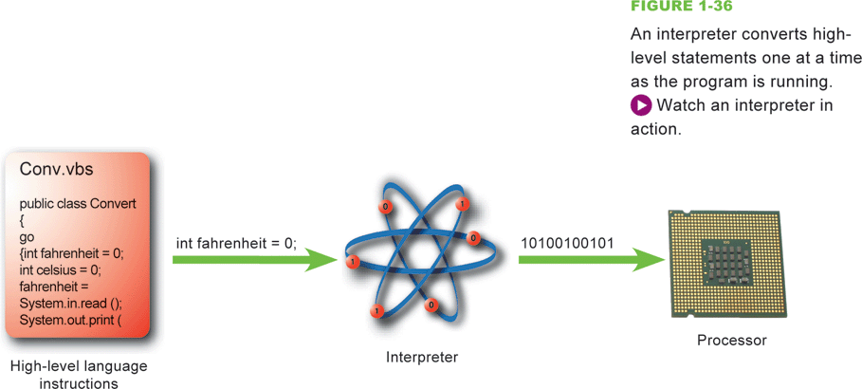
Programs and Instruction Sets

Slide 41
Programs and Instruction Sets
A microprocessor is hard-wired to perform a limited set of activities, such as addition, subtraction, counting, and comparisons, called an instruction set
Each instruction has a corresponding sequence of 0s and 1s
The end product is called machine code
1s and 0s

Slide 42

Programs and Instruction Sets
An op code (short for operation code) is a command word for an operation such as add, compare, or jump
The operand for an instruction specifies the data, or the address of the data, for the operation
In the following instruction, the op code means add and the operand is 1, so the instruction means Add 1

Slide 43
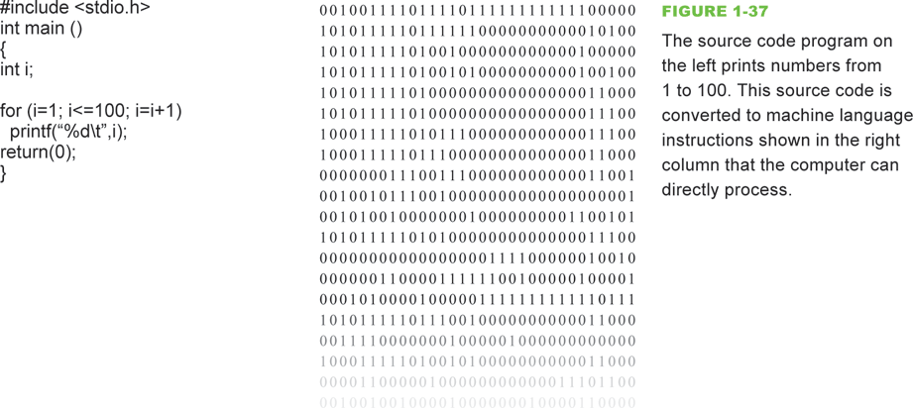
Programs and Instruction Sets

Slide 44
Processor Logic
The ALU (arithmetic logic unit) is the part of the microprocessor that performs arithmetic operations
The ALU uses registers to hold data that is being processed
The microprocessor’s control unit fetches each instruction, just as you get each ingredient out of a cupboard or the refrigerator
The term instruction cycle refers to the process in which a computer executes a single instruction

Slide 45
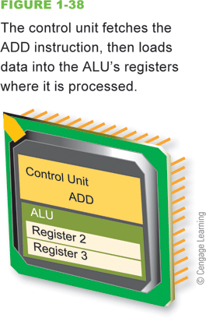
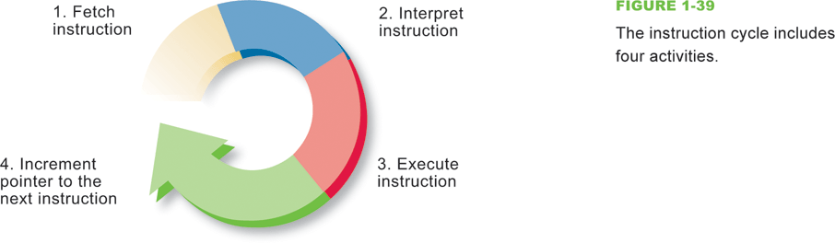
Processor Logic

Slide 46
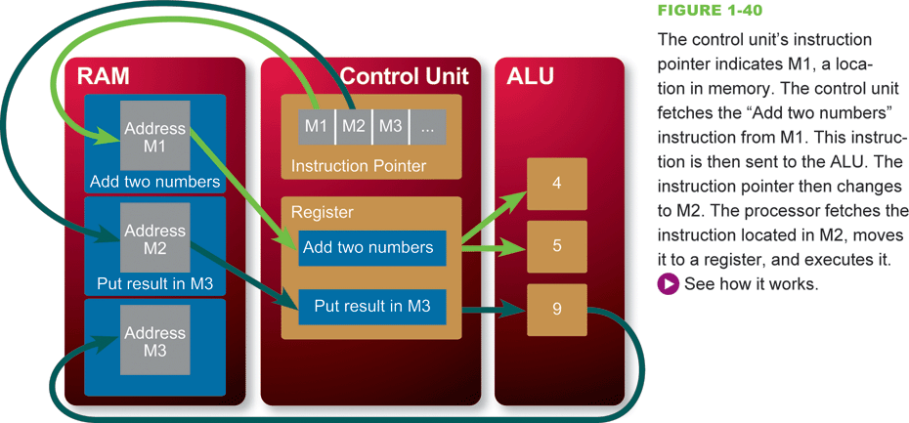
Processor Logic

